Slide 1

DEPARTMENT OF COMPUTER SCIENCE & ENGINEERING
Jawaharlal Nehru New College of Engineering
Shimoga - 577204.
Phase-2 Project Seminar
“IoT based Water Purity Level Indicator for Household and Water Distribution points.’’ ( Funded by NSTEDB, DST, Govt of India & Implemented by EDII, Ahmedabad )
Project Presentation by :
GREESHMA VS HARSHA KL
MR VAISHANAVI
NEHA CB
4JN18CS029
4JN18CS032
4JN18CS042
4JN18CS056
Under the Guidance of :
Dr. NIRMALA SHIVANAND M.Tech ,Ph.D.
Professor, Dept. of CS&E
Project Cordinators:
Sandeep S ,M.Tech
Assistant.Prof Namitha M.V ,M.Tech
Assistant.Prof
Dr.Sankhya N Nayak M.Tech, Ph.D Associate.Prof Dr.Ravindra S M.Tech ,Ph.D
Associate.Prof

Slide 2
List of Content:
Abstract
Motivation for selecting this project
Problem Statement
Goals and Objectives
literature survey
Results and analysis
Conclusions

Slide 3
ABSTRACT:
Water is an important resource for life of every living organism. Water Pollution is a major global problem. It has been surveyed that water pollution is the leading cause of deaths and diseases in human and marine life. In this project work an IoT based model for water quality monitoring is proposed and developed. The values for parameters pH, turbidity, TDS etc. Are collected using sensors in real time basis and values are uploaded to cloud layer. Data is analyzed and prediction about the water quality is carried using ML algorithm.An application program is developed to send the message regarding the water qulity to users. Also message is sent to concerned authority for further actions.

Slide 4

Motivation :
Water pollution is a major global problem.
It has been surveyed that water pollution is the leading cause of deaths and diseases in human and marine life.
Existing solution is manual and time consuming so an automatic real time product is in demand.
As human intervention is prone to error, machine learning algorithm for water quality measurement is preferred.
As phones are the fastest way to communicate with people, building an app for the output display is convenient.

Slide 5


Problem Statement:
Due to the fast-growing urbanization supply of safe drinking water is a challenge. Using traditional approaches of monitoring water quality in the water management system are not completely safe and time consuming. Existing solution accumulate all possible values of water quality deciding parameters and manually come to a conclusion whether the water is consumable or not. So, an automatic real-time monitoring system is required to monitor the status of the water.

Slide 6
Objectives:
Acquiring the water quality measuring parameters by sensors.
Storing data in cloud for easy access and security.
Use of ML algorithm for quick analysis to classify water quality as drinkable, utility or other purpose.
Designing of user friendly app for displaying the output along with alerts.

Slide 7
Goals
Hardware Requirement
An IoT device Arduino uno Wi-Fi rev 2 is selected and sensors like pH, TDS, Turbidity are connected together and measured the parameters which decide the water quality.
Data set creation
Water samples like Drinking water, Bore water, RO water, River water, salt water etc are used and created datasets are uploaded to cloud firestore.
Training the datasets
Datasets generated are fed into ML algorithm like random forest, for training.
Deploy the result in App and website
The current parameters of water are displayed in app and website, alerts are sent to the android phone when the water is impure.

Slide 8
LITERATURE SURVEY
Sl. No | Paper information | Year | Methodology | contribution | Advantages | Limitations
1 | Title/Paper: Smart water quality monitoring system Author: A.N.Prasad, K. A. Mamun, F. R. Islam, H.Haqva | 2015 | The parameters were chosen to be composed of pH, oxidation and reduction potential (ORP) and temperature. Further these values are sent through ADC (Analog & digital converter), & the data is further processed in micro controller. The data collected is stored on cloud that can be accessed later. | This paper presents a smart seawater quality monitoring system in an effort to aid in water pollution control in Fiji with the help of IoT and RS technology. | Provides notification battery life and progress report. The system has proved its worth by delivering accurate and consistent data throughout the testing period. | measures water quality in sea water only. The system gets a 15 minutes sleep time after an hour of continuous readings.

Slide 9
Sl. No | Paper information | Year | Methodology | contribution | Advantages | Limitations
2 | Title/Paper: Real Time Water Quality Monitoring System Authors: Jyotirmaya Ijaradar, Subhasish Chatterjee | 2017 | They have developed a system using Raspberry Pi. pH, Turbidity and Temperature sensors. the corresponding data is stored in the cloud . Trigger alarm when any impurities are found in the water quality. | Monitor water quality automatically. Triggers alarms immediately does not require people on duty. So, the system is likely to be more economical, convenient and fast. | Does not require people on duty It is low in cost The system has good flexibility. The operation is simple. | Less reliable The frequency of testing is very low.

Slide 10
Sl. No | Paper information | Year | Methodology | contribution | Advantages | Limitations
3 | Title/Paper: Design of Robotic Fish for Aquatic Environment Monitoring Authors: Anuradha A. Maindalkar, Saniya M. Ansari | 2015 | Here Robotic fish consist of sensor and camera Raspberry Pi is used for video processing and sending the video to the user through the Bluetooth is used for communication. System work between Arduino and Raspberry Pi(ARM Processor). A robotic fish is capable of moving in water by DC motor This motor is manipulated by a programmable control broad | Here robotic fish was deployed in water to measure Water quality They design the robotic fish system where they implement through android smartphone through this they accurately detect the debris This can detect the behavior of water which can occur due to chemical, natural weather change . | 1.aquatic robot can accurately detect debris. 2. It measures various contaminants | 1.chances of battery depletion from the robotic fish 2.It requires a man to go into water and deploy the hardware system inside

Slide 11
Sl. No | Paper information | Year | Methodology | contribution | Advantages | Limitations
4 | Title/Paper: Detection of Impurities in Water by Measuring Capacitance Authors: Jamil Wahid and Q. Ahsan | 2014 | The analysis are The sensor consists of two parallel conducting (copper) plates. Constructed on copper clad substrate boards. Insulated the copper plates by coating it with varnish oil. At first sensor circuit was immersed into the sample by taking the average value we will detect the impurities | This paper investigates the impurities present in water A low cost parallel plate based capacitive sensor is designed and implemented for the experimental setup. It analysis different concentrations of Sodium Chloride , FerrousSulphate and Copper Sulphate | 1.Detects unhygienic impurities in water 2.Low cost effective | 1.Difficult to determine impurity by direct chemical analysis 2. Copper plate can be corded easily 3.Detection of impurities in non-binary solutions is not possible.

Slide 12
Sl. No | Paper information | Year | Methodology | contribution | Advantages | Limitations
5 | Title/Paper: Water Quality monitering and control using Wireless Sensor Networks Author: Mr. Vikas Mane1, Mr. Pranav Medsinge2, Mr. Akash Chavan3, Mr. Sudhakar Patil4 | 2017 | In this paper they used different sensors to measure water pH, conductivity, dissolved oxygen (DO) and temperature. Different push buttons are provided for reading the temperature, pH, rain and turbidity values .Once the user clicks on any of the push buttons of the panel the RF transceiver on the transmitter side sends a signal to the RF receiver on the receiver side. GUI is provided at base station. | The proposed system is using high power RF based WSN for water quality monitoring system offers low power consumption with high reliability. The use of natural solar energy helps to reduce power consumption & operating cost. | Long battery life sensors are powered by solar panel. Easy installation of the system where the base station can be placed at the local residence close to the target area. | This system cannot be used in industrial standards. The maintenance could be a bit more as there is a possibility of corrosion of sensors due to temperature.

Slide 13
Sl. No | Paper information | Year | Methodology | contribution | Advantages | Limitations
6 | Title/Paper: Advanced Water Impurity Detection System Authors: Anand K R, Antony K A, Gipin Antony Joseph, Sabareesh Sajin Fareeda A Kareem | 2017 | Two solenoid values to control input and output outlets are controlled based on the values measured by sensors like Ph sensors, Laser etc. Pure water is supplied only when it passes the quality check otherwise it will be released for agriculture and other purposes. | The system was tested and found to detect multiple impurities with alerts. The Physical impurities like deposition of sand, mud, rust etc analyzed and report is sent immediately and documented. | Detects unhygienic impurities in water. Controls input and output of water for efficiency. | By making sensors more precise we can extent it to industrial use. Flush on Request’ option must be modified as water should be used wisely and is no good for irrigation.

Slide 14
Sl. No | Paper information | Year | Methodology | contribution | Advantages | Limitations
7 | Title/Paper: Reconfigurable Smart Water Quality Monitoring System in IoT Environment Authors: Cho Zin Myint Lenin Gopal Yan Lin Aung | 2017 | A reconfigurable smart sensor interface device that integrates data collection, data processing, and wireless transmission is designed The water quality monitoring system consists of a group of sensors to monitor the water parameters. | It is a reconfigurable smart sensor devise. Uses 5 parameters like water level, pH, turbidity, temperature, and co2 levels making it more reliable and feasible. | It is a reconfigurable smart sensor devise The proposed system will assist in protecting the ecological environment of water resources. | It has high complex hardware and software. Needs more man power and maintenance. Maintenance becomes costly.

Slide 15
Sl. No | Paper information | Year | Methodology | contribution | Advantages | Limitations
8 | Title/Paper: Water Quality Measuring System Using Wireless Sensor Network Authors: Bishwajit Paul | 2018 | They have developed a system using pH and Temperature sensors. A microcontroller is used as a sensor node which stores real time data and sends the data to the cloud storage via Wi-Fi. There is also a GSM shield connected to microcontroller which sends the text notification to mobile device | This model can detect pollution remotely and take necessary actions Here they monitored water parameters such as temperature. It checks quality of water at the places where generally it is inconvenient to take frequent tests manually. | Less power consumption Natural resources like solar energy can be used. Connection is easy. | establishing a system with more sensor nodes and more base stations. The connections between nodes and base station can be done using Ethernet.

Slide 16
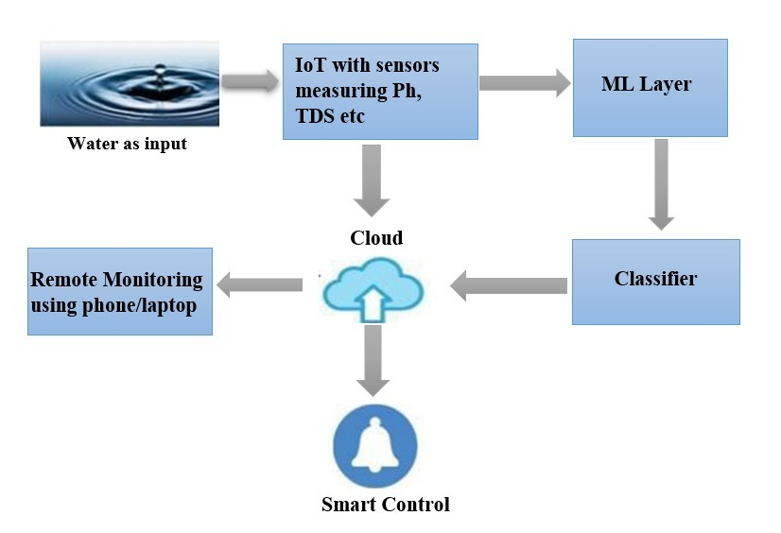
System Architecture
Fig 1: System Architecture

Slide 17
Step 1: Creation of dataset
A dataset is created on our own .
for training the ML algorithm, for creating water samples used are Drinking water, Bore water, RO water, River water, salt water etc.
No of samples are 500+
Step 2: An IoT device -Arduino is connected with all the sensors and their data is sent to Thingspeak.
Thingspeak – ThingSpeak is IoT Cloud platform where you can send sensor data to the cloud.

Slide 18
Step 3: The data sent to Thing speak is retrieved by web-server called Flask and data analysis is done here.
Step 4: Data analysis and prediction about the water quality is carried using Random forest algorithm .

Slide 19
Step 5: The result is uploaded into the cloud fire store.
Step 6: An app is built to display the current parameters with quality of water and a notification is sent when water quality is impure.
Step 7: A website is also present to display the current parameters and also thing speak gives a detailed statistics about the overall measurements which is helpful for data analysis of water.

Slide 20
Results and analysis:
The implementation of project is done using python programming
Hardware requirements
pH, Turbidity, TDS and Temperature.
Arduino Uno Rev2 Wi-Fi module(IoT device)
Breadboard, Convertors and Jumper wires
Software requirements
Cpp programming in Arduino and ML algorithms
Arduino IDE- An IoT Platform
Firestore/cloud store for storage
Web interface / Alerts in android app

Slide 21
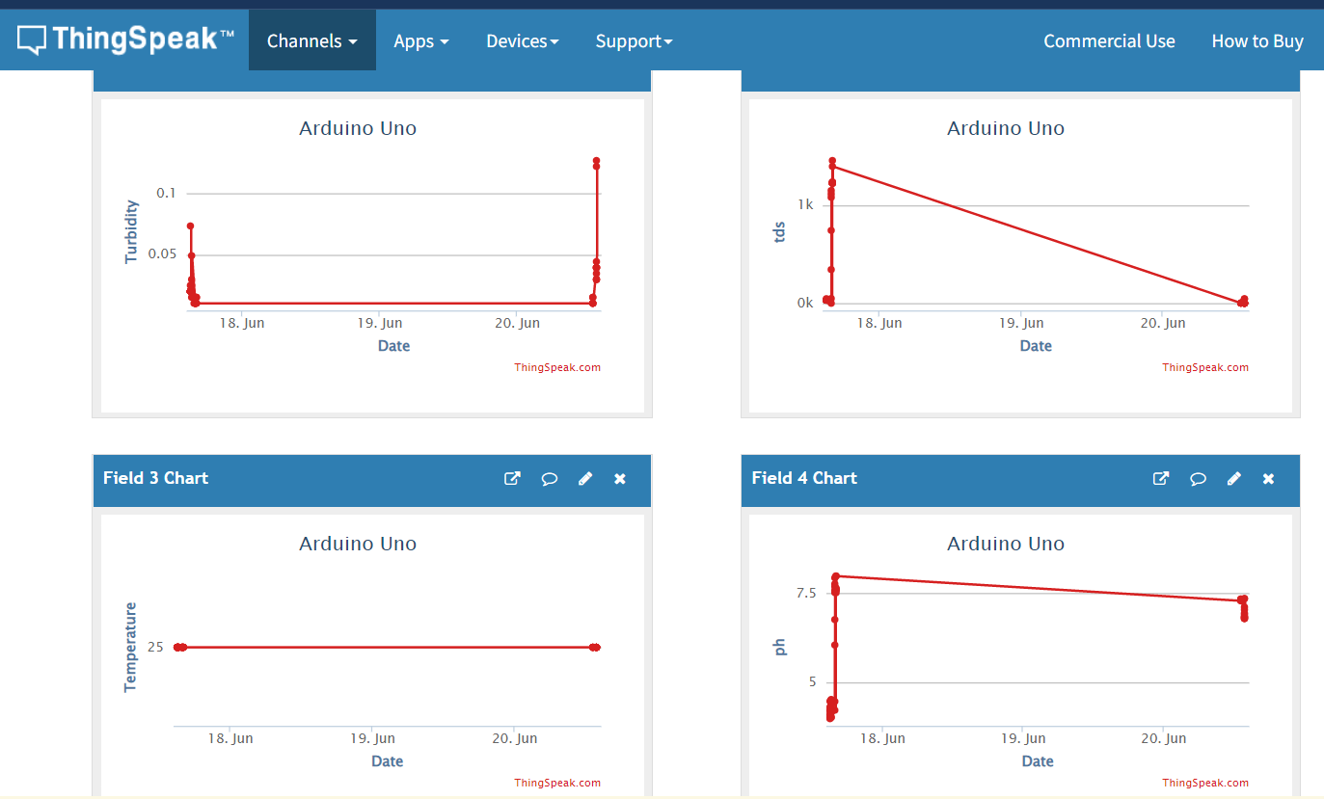
Snapshots:
Fig 2:Graphical representation of current parameter values of water in ThingSpeak

Slide 22
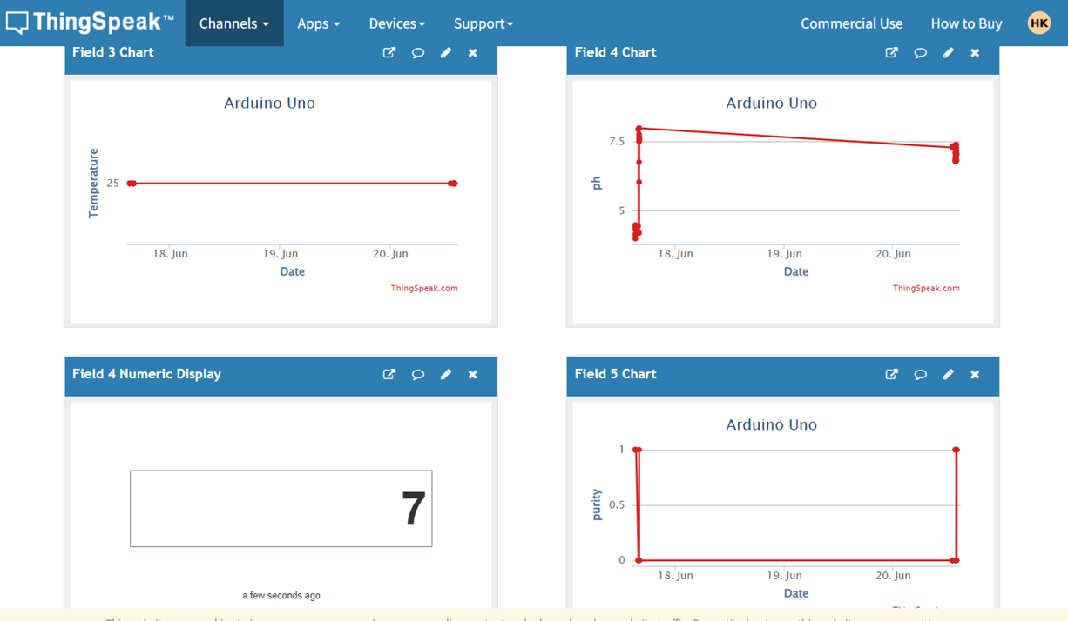

Slide 23
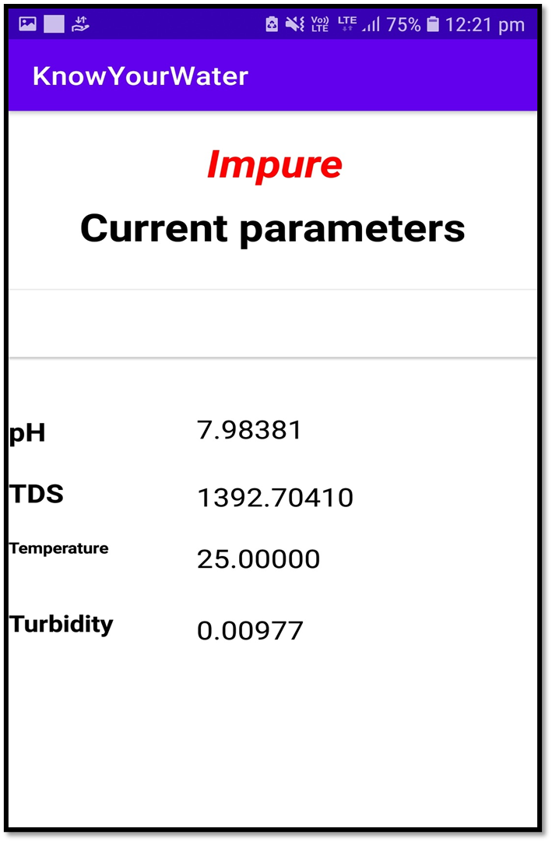
Fig 3: Showing current parameter values and status as Impure in App

Slide 24
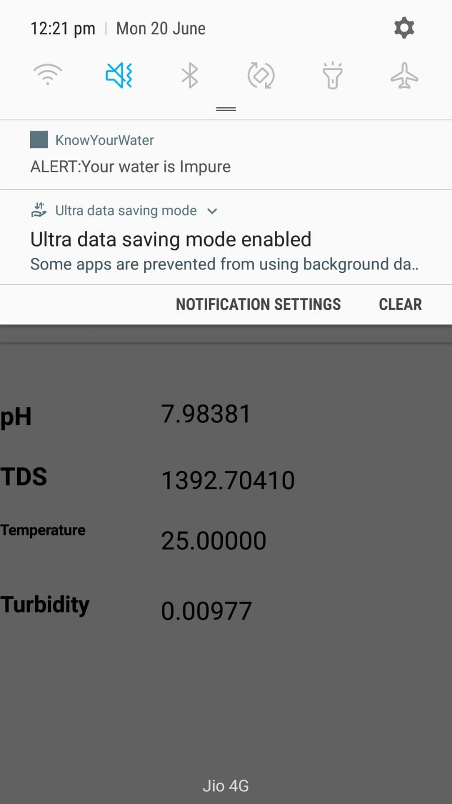
Fig 4 : Alert Message when water is Impure

Slide 25
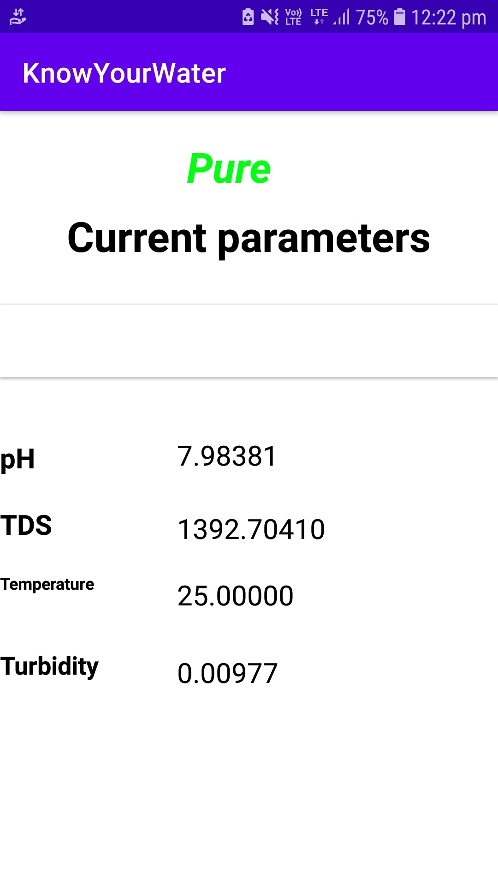
Fig 5 : Showing current parameter values and status as pure in App

Slide 26
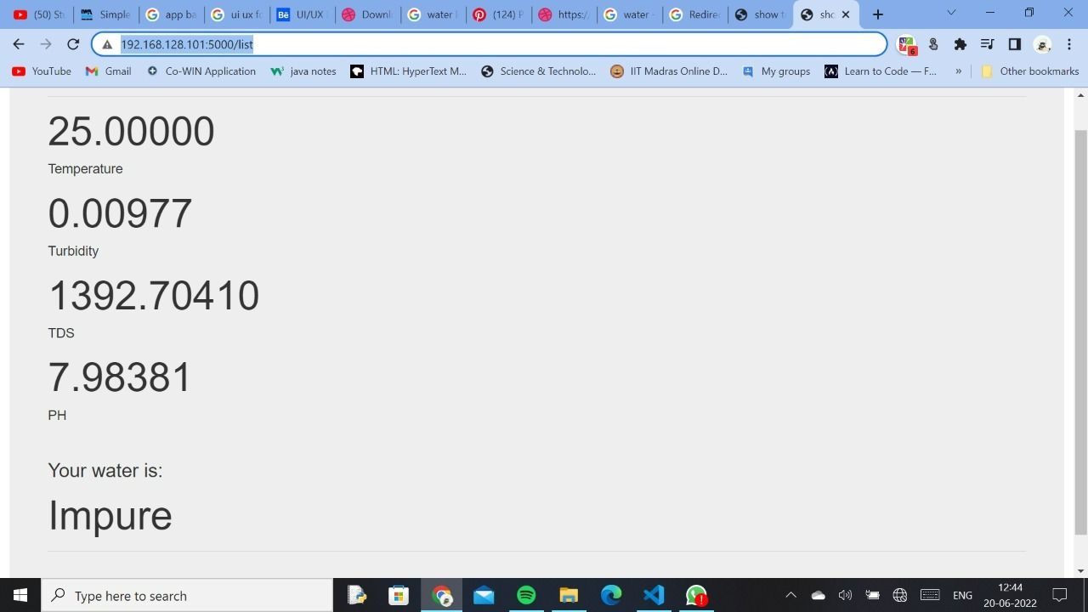
Fig 6: Current parameters are shown in website

Slide 27
Conclusion:
The product is a compact device that records various water quality measuring parameters in real-time.
The water quality is displayed through smart alerts on a user-friendly App.
The product can give detailed analytics to offices monitoring water distribution points. Based on the analytics, different actions can be adapted.

Slide 28
Bibliography
[1] https://www.experts-exchange.com/articles/29567/How-to-connect-Arduino-Uno-WiFi-to- ThingSpeak.html
[2] https://thingspeak.com/channels
[3] https://www.tutorialkart.com/kotlin-android/kotlin-android-button-text-color/
[4] https://en.wikipedia.org/wiki/Web_Server_Gateway_Interface
[5] Jamil Wahid and Q. Ahsan, “Detection of impurities in water by measuring capacitance”, (IEEE) 8th International Conference on Electrical and Computer Engineering, 20-22 December, 2014, ISBN: 978-1-4799- 4166-7.
[6] Maindalkar, A and Ansair, S M (2015). “Design of Robotic Fish For Aquatic Environment Monitoring”, International Journal of Computer Applications,Vol.117(17), pp.31-34

Slide 29
[7] A.N.Prasad, K. A. Mamun, F. R. Islam, H. Haqva , “Smart Water Quality Monitoring System”, School of Engineering and Physics University of the South Pacific Laucala (2015), Fiji Islands
[8] “Water Quality Measuring System Using Wireless Sensor Network” Mr. Vikas Mane, Mr. Pranav Medsinge, Mr. Akash Chavan, Mr. Sudhakar Patil Department of E&TC, Sanjeevan Engineering & Technology Institute, Panhala, Shivaji University Kolhapur, Maharashtra, India
[9] Cho Zin Myint, Lenin Gopal and Yan Lin Aung, “Reconfigurable smart water quality monitoring system in IoT environment”, (IEEE) 2017 IEEE/ACIS 16th International Conference on Computer and Information Science (ICIS), ISBN: 978-1-5090-5507-4.

Slide 30


